Slide 1
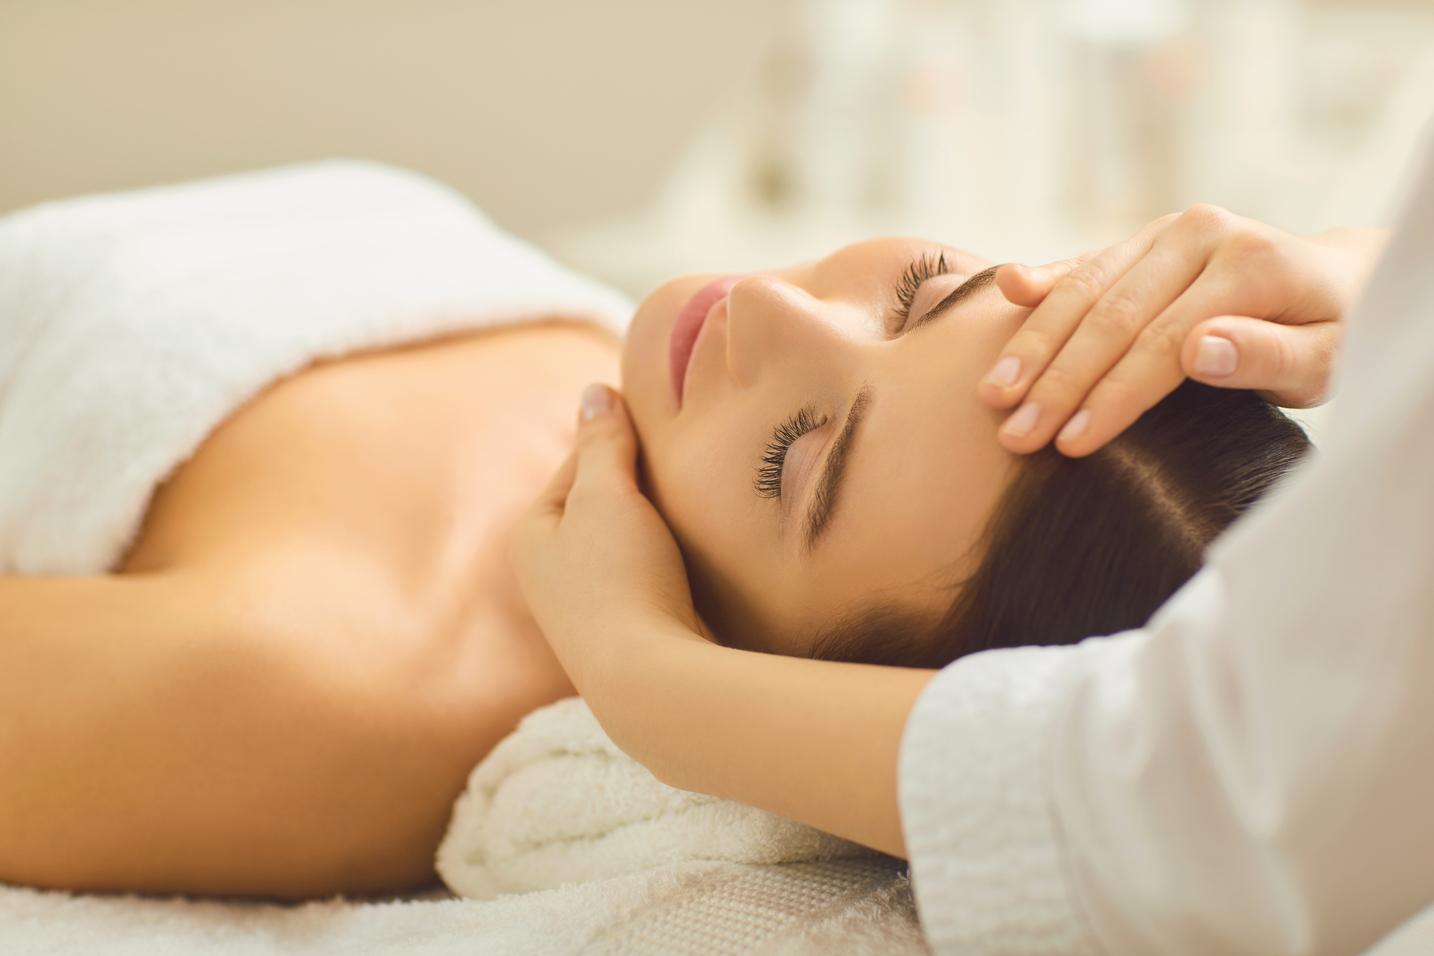
THE
SPA APPOINTMENT
BOOKING SYSTEM
August, 2023
-R.A. Mohan Tiwari, Saroj Baral

Slide 2

INTRODUCTION
The SPA Appointment Booking System
is
•Digitalized application to manage appointments.
•Why was this idea proposed?
•Feasibility of the SPA Appointment Booking System.
•What kind of application is it?
•Where does this system mainly focus on?

Slide 3

PROBLEM STATEMENTS:
Micro level
Macro level
Time Consuming
Lack of Convenience
Tension due to manual recording
Lack of tech adaptation
Difficulty in competing in the market

Slide 4

OBJECTIVES
Solving issues in Spas by:
Easier Registration
Easier Appointment management
User-friendly
To improvise in business
Secured platform
Edit price feature

Slide 5

BUSINESS REQUIREMENTS
The Non-Fuctional requirements are:
·Increased efficiency
User friendly Interface
Secured system
Flexible system
The functional requirements are:
Normal User ​
User Login ​
Add New book ​
Search Book ​
Edit Book​
Delete Book
The technical requirements are:
Programming Language in C
File Based Database
Visual studio code
GCC compiler

Slide 6

SYSTEM DESIGN:
The section of the Design in documentation includes Data Flow Diagrams (DFD), flowcharts, E-R diagram providing a more comprehensive understanding of our system's design.

Slide 7

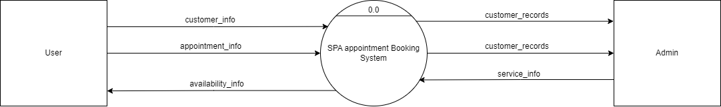
DFD LEVEL 0
FIG: DFD 0

Slide 8
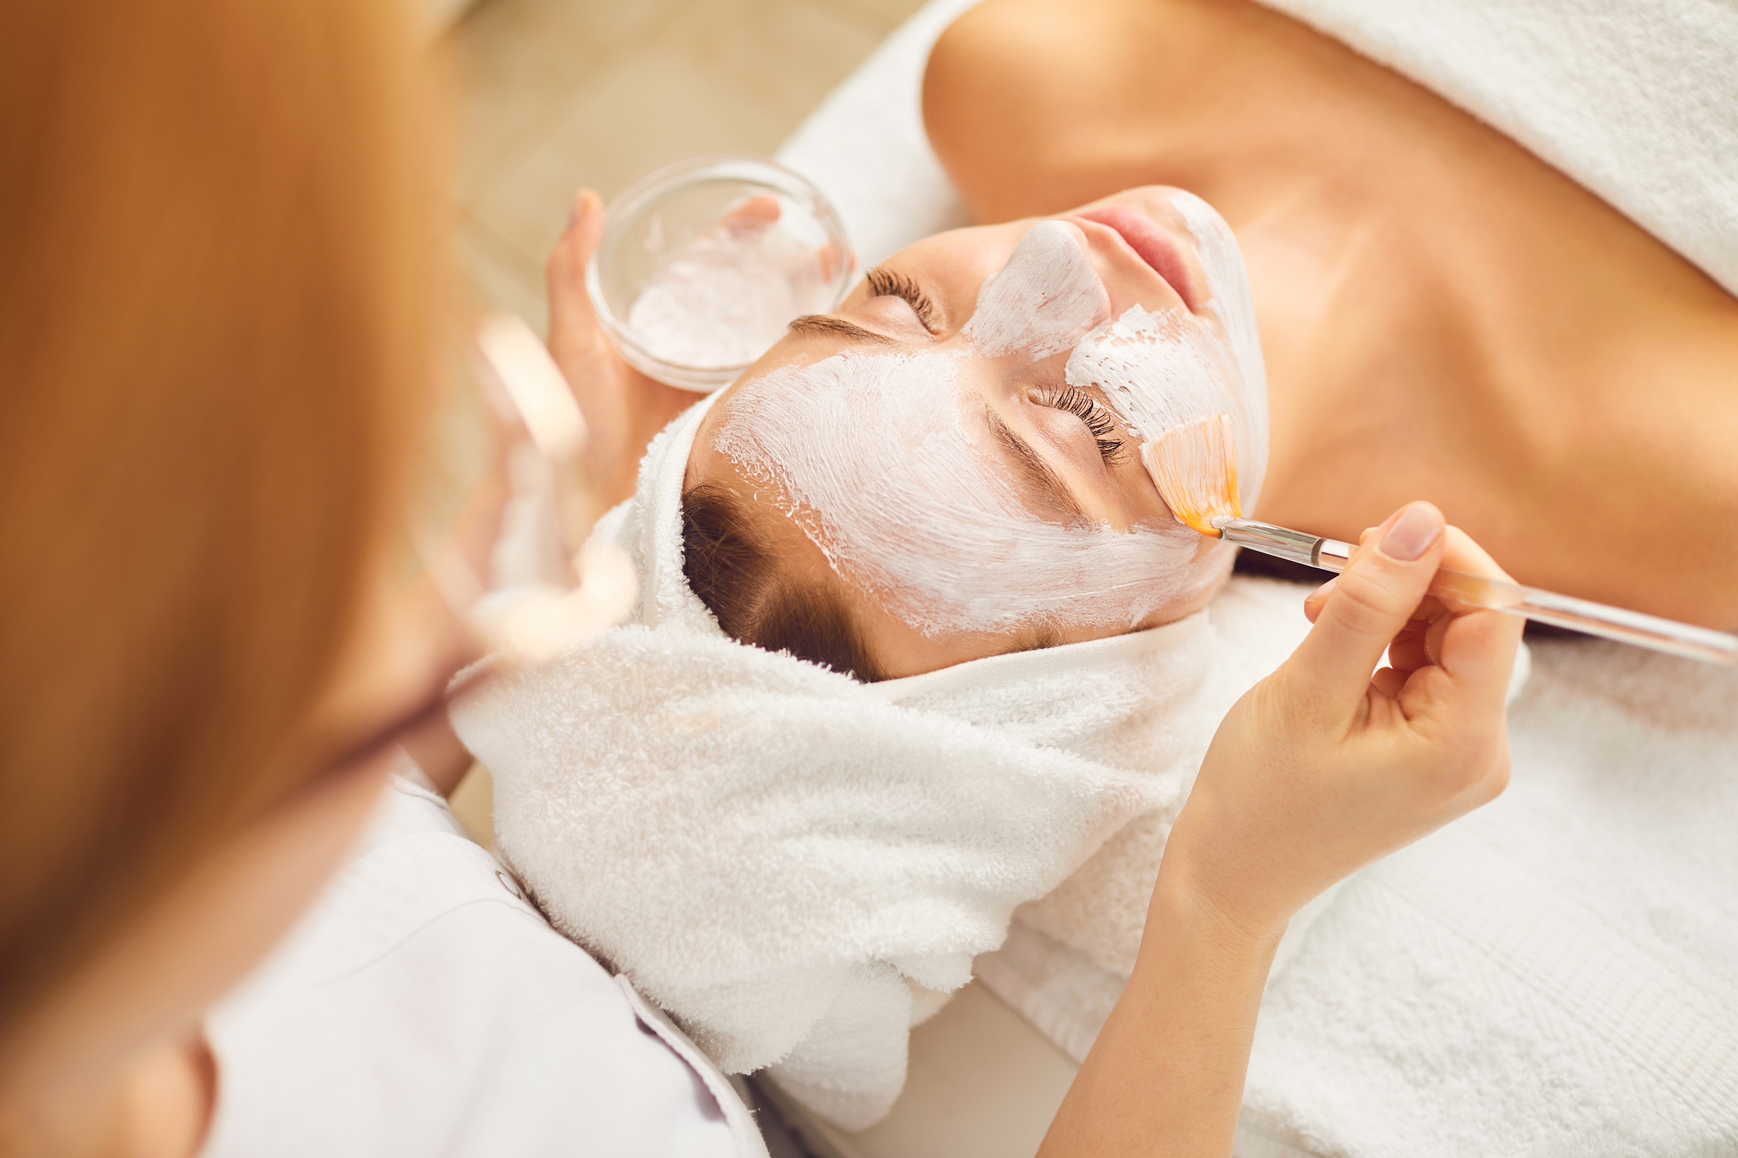
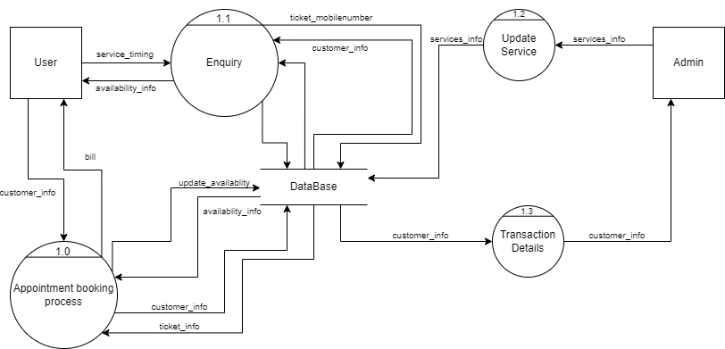
DFD LEVEL 1
FIG: DFD 1

Slide 9
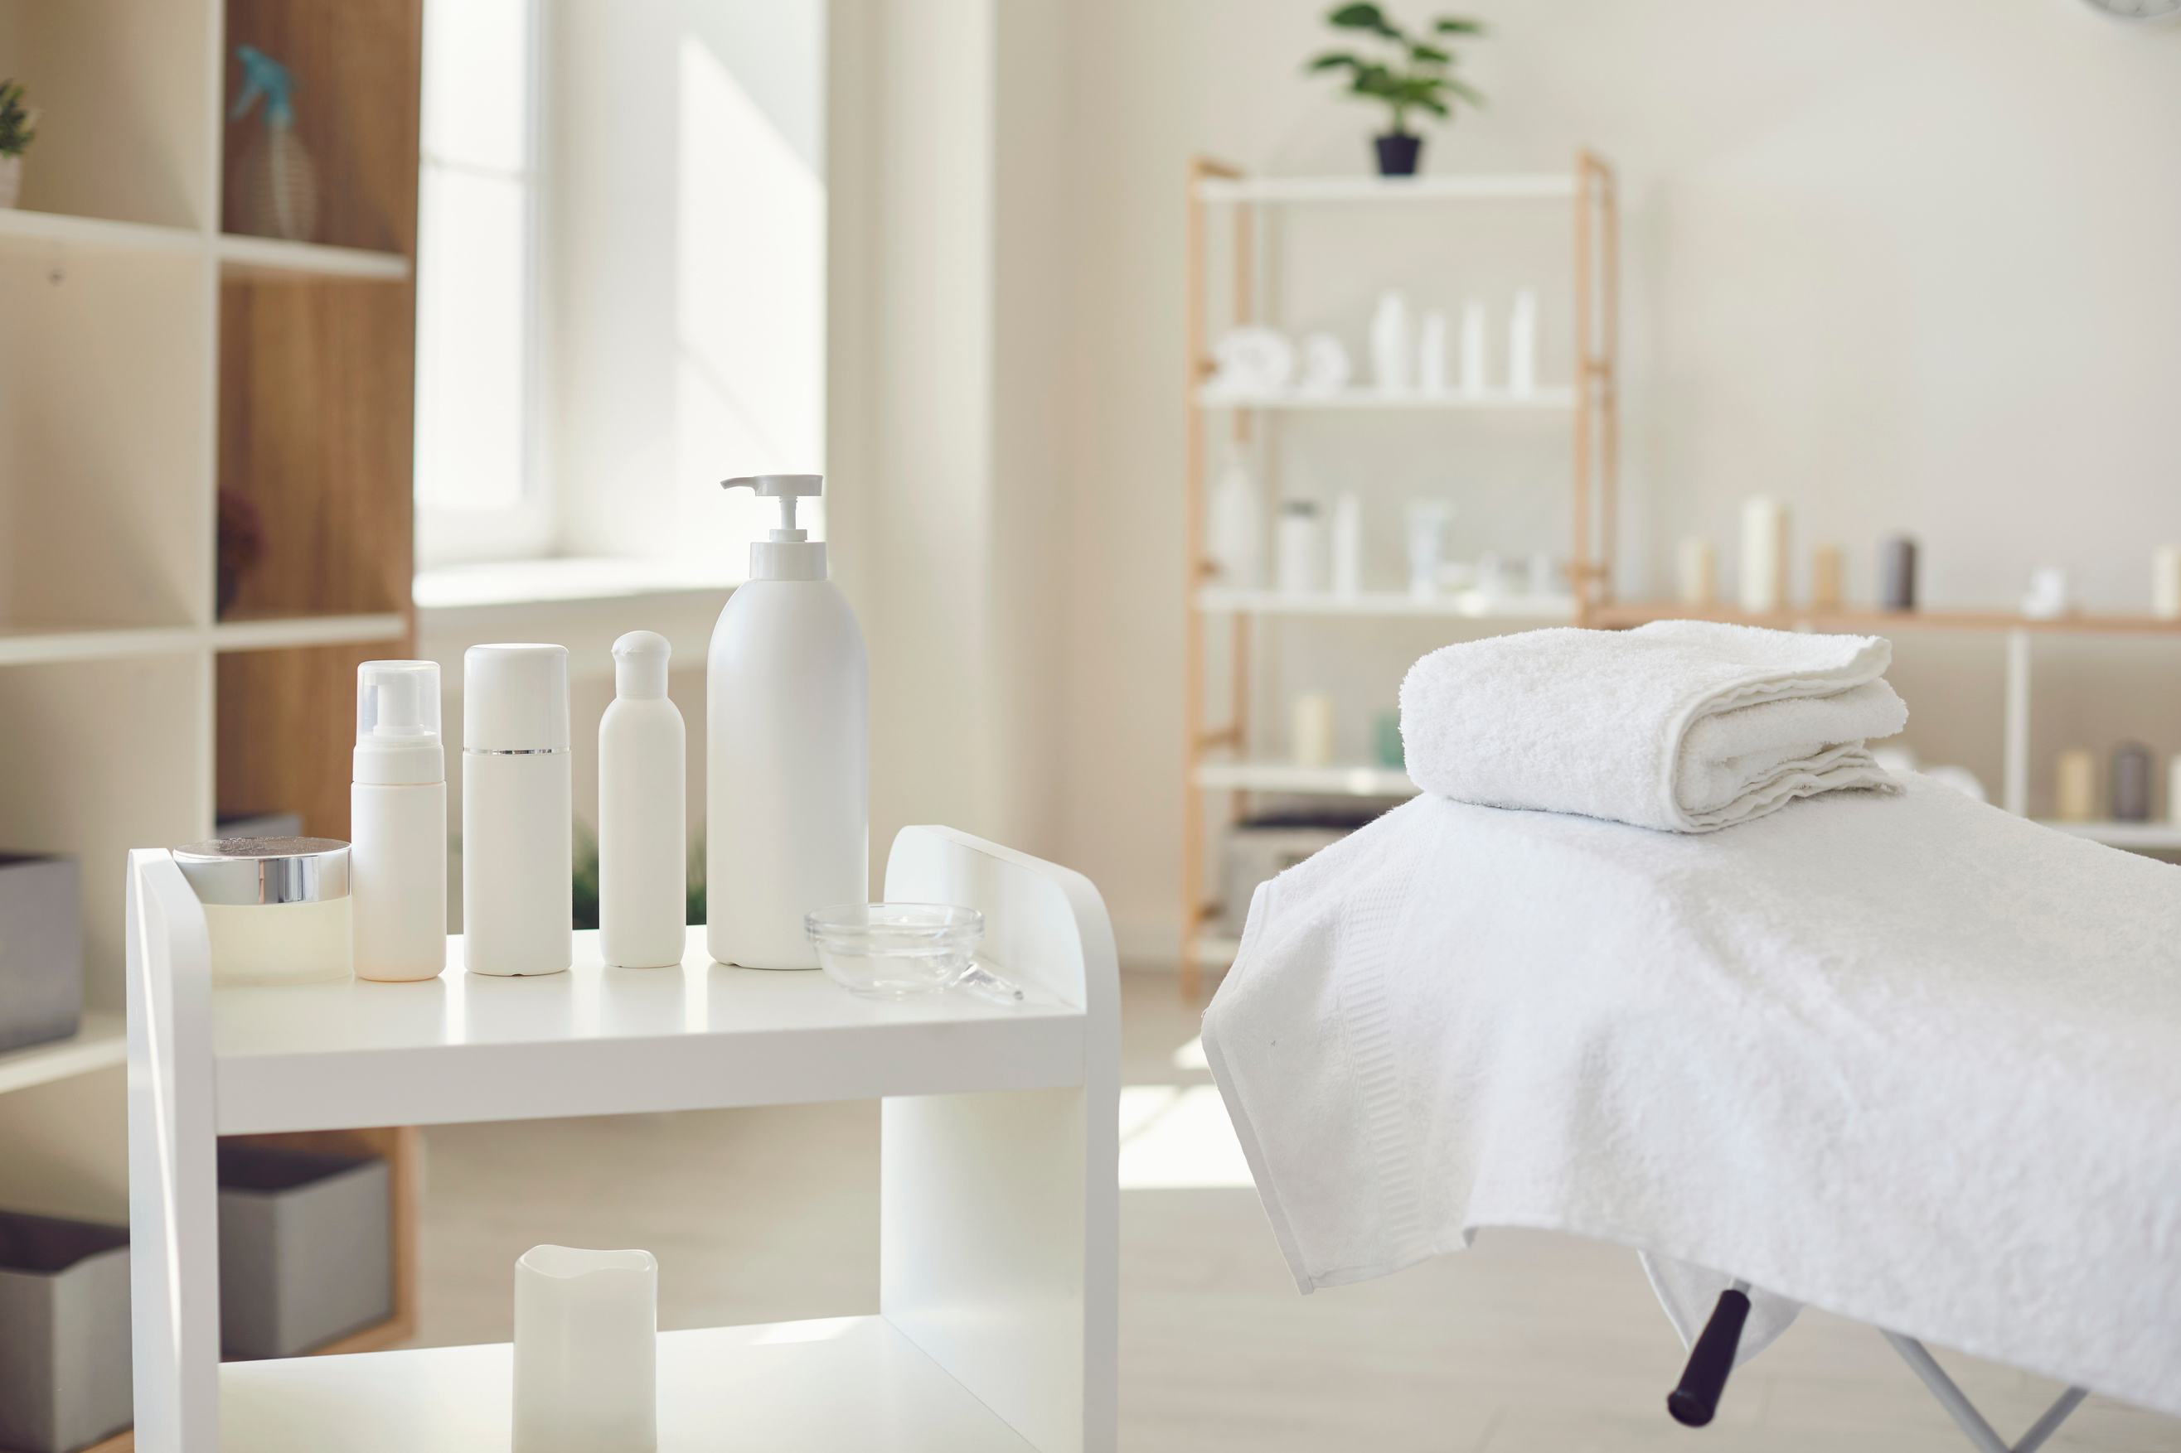
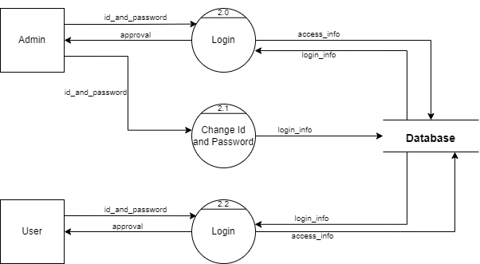
DFD LEVEL 2: LOGIN
FIG: DFD 2: login1

Slide 10
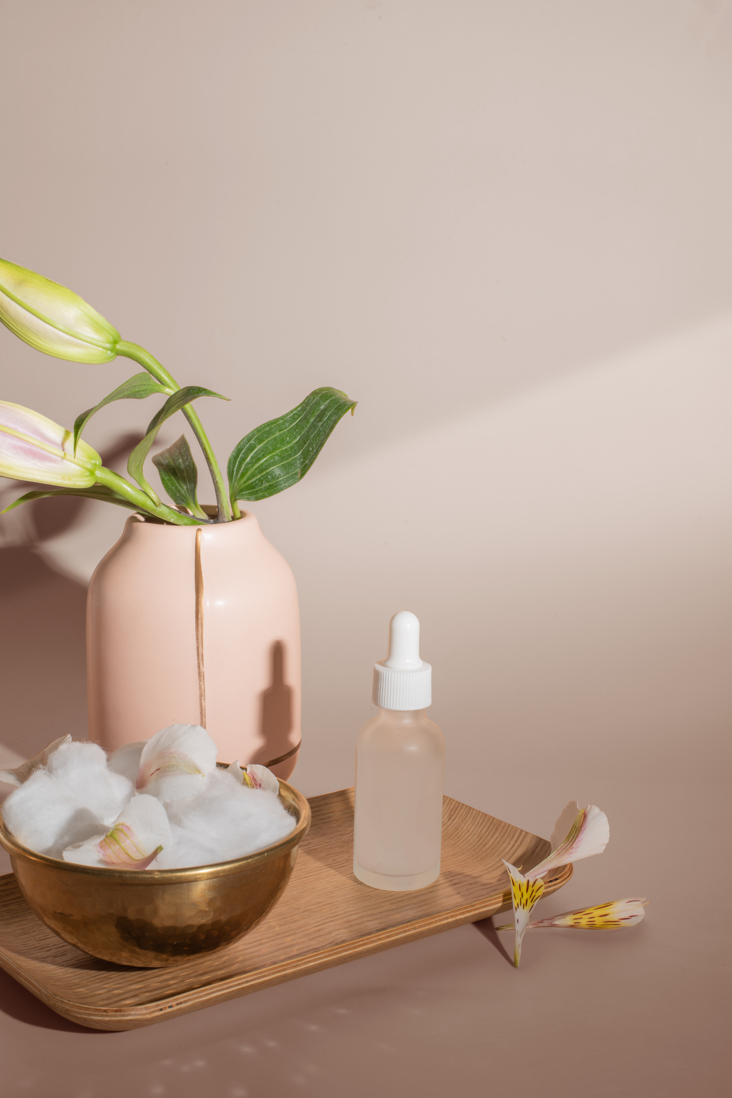
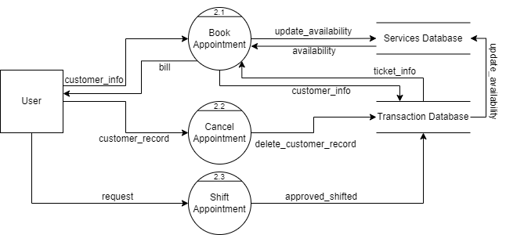
DFD LEVEL 2: USER
FIG: DFD 2: USER

Slide 11

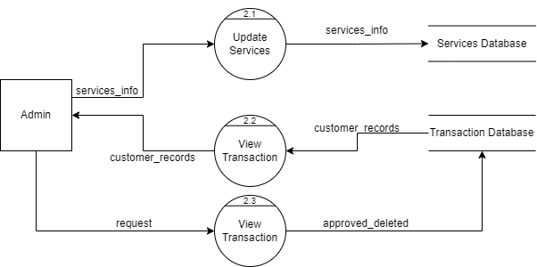
DFD LEVEL 2: ADMIN
FIG: DFD 2: ADMIN

Slide 12

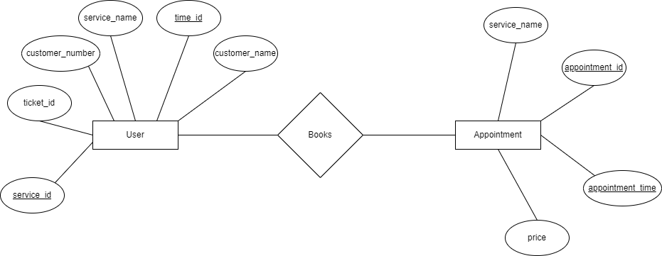
ENTITY RELATIONSHIP DIAGRAM
Fig: E-R Diagram

Slide 13
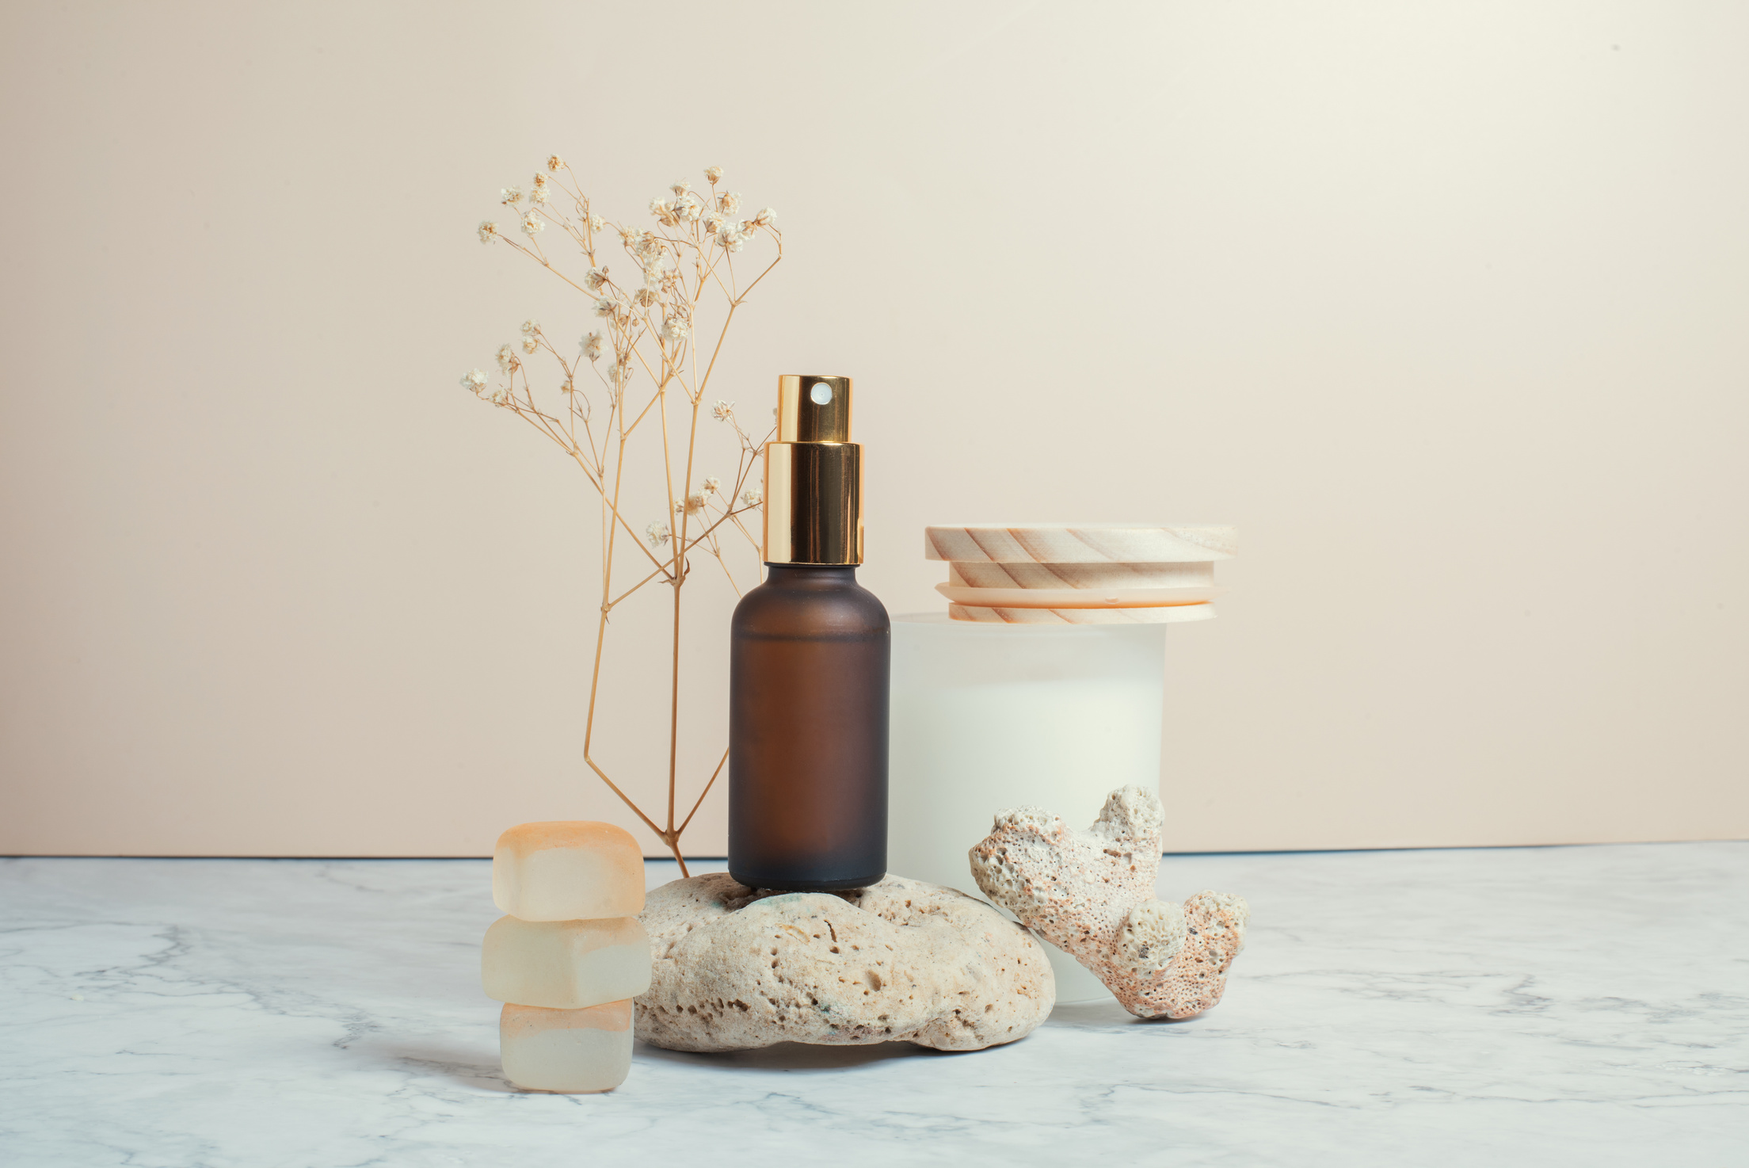
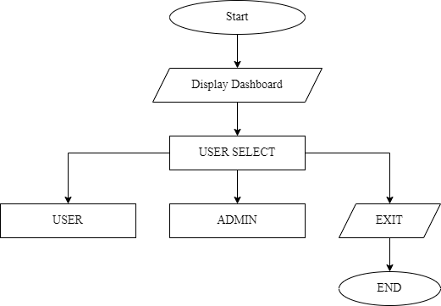
FLOWCHART: USER SELECTION
Fig: Flowchart: User selection

Slide 14
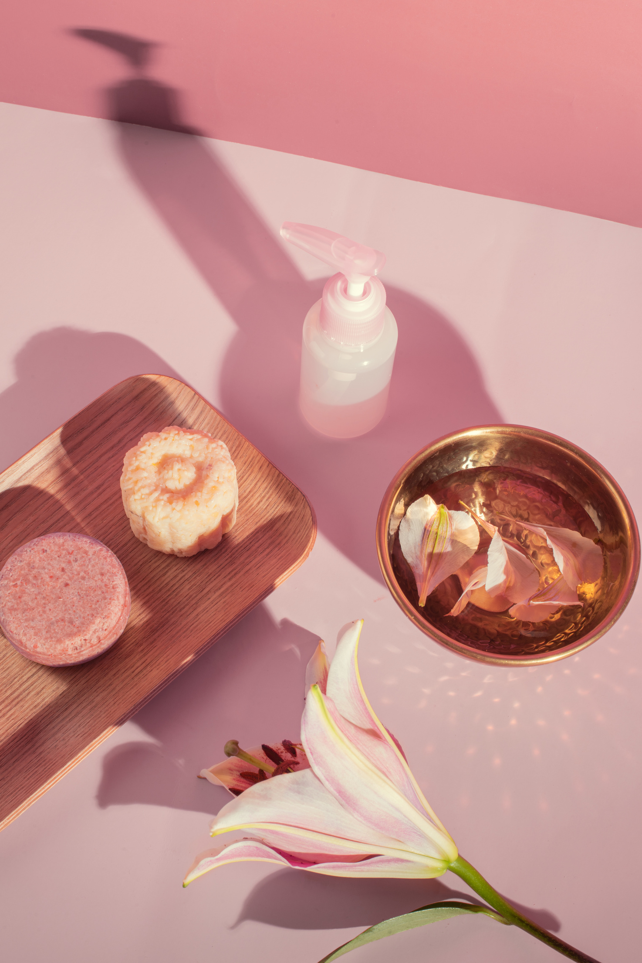
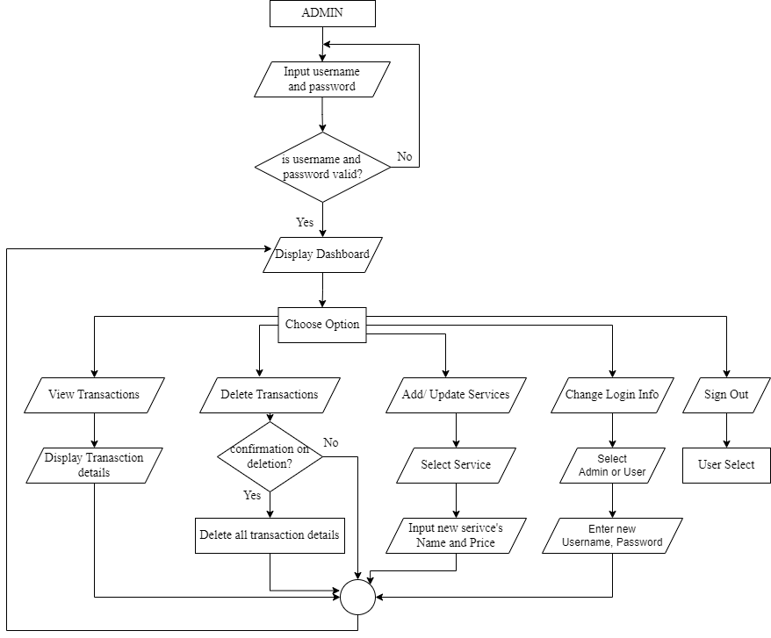
FLOWCHART: ADMIN
Fig: Flowchart: Adminn

Slide 15
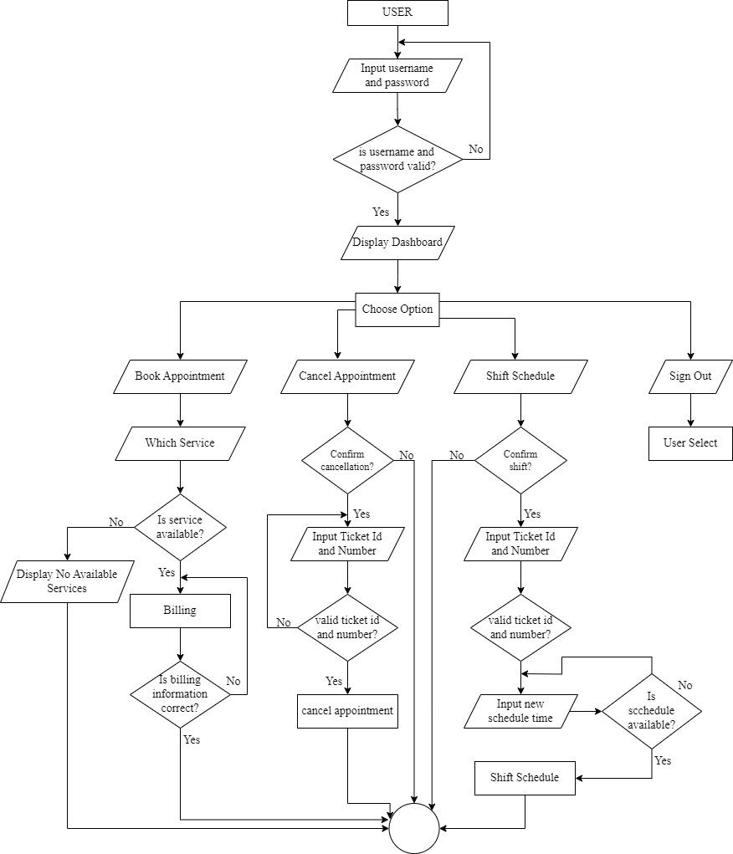

FLOWCHART: USER
Fig: Flowchart: User

Slide 16
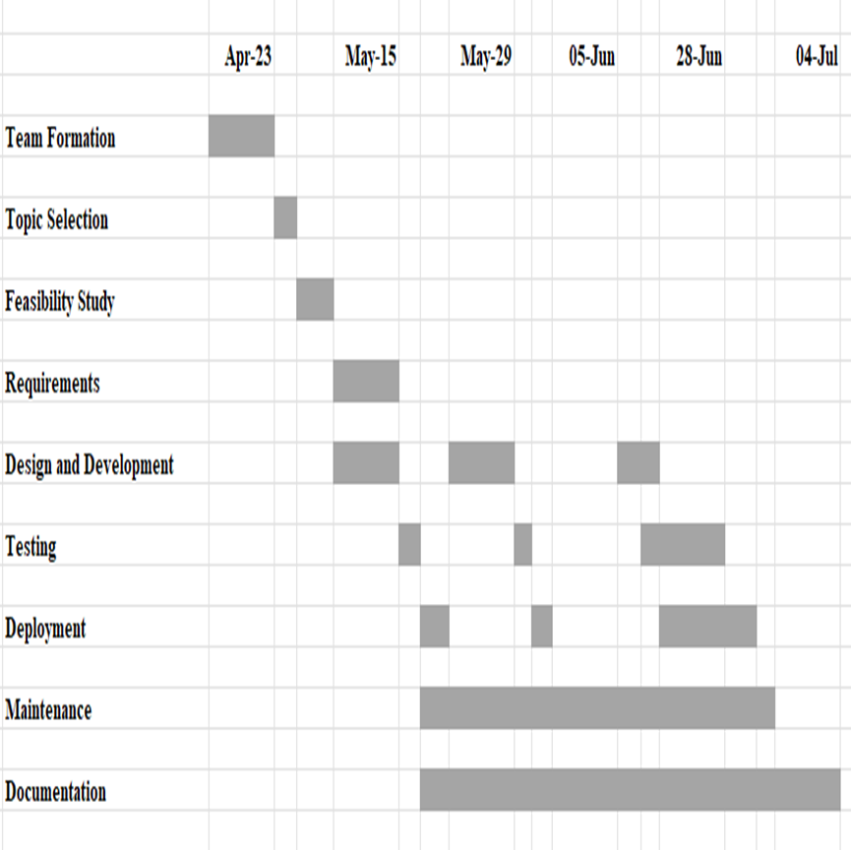
GANTT CHART
Fig: Gantt Chart

Slide 17
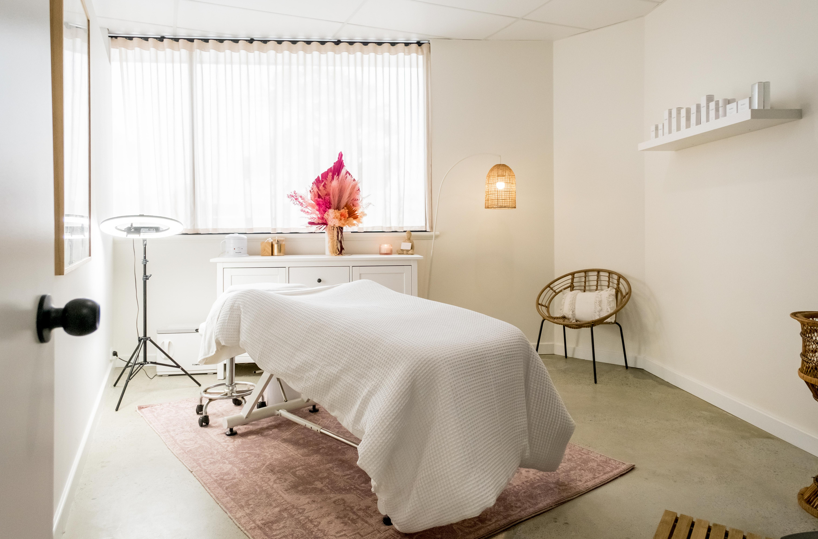
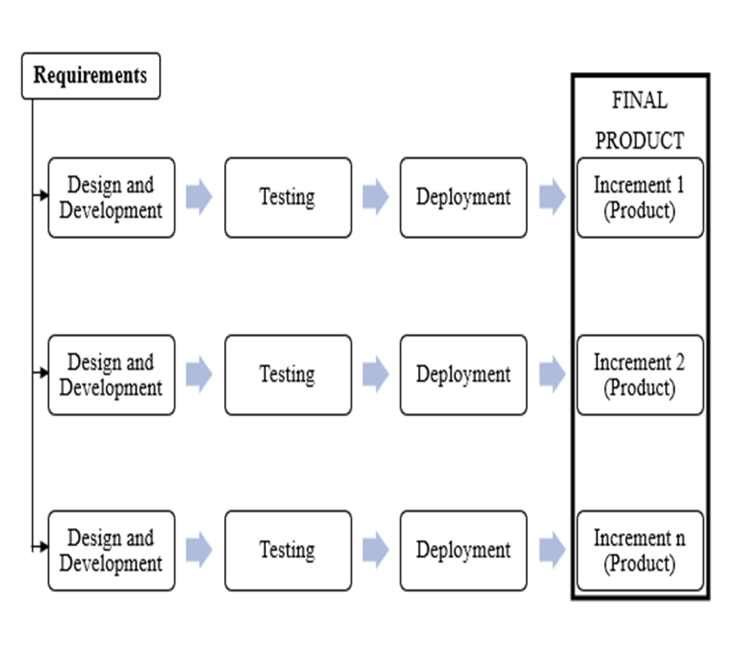
DEVELOPMENT METHODOLOY
Incremental Model
The system becomes easier to develop as requirements are gathered at once and is divided into parts to build an increment and in those increments proper priority is given to every features of the system. There’s proper loop of doing things rather than taking a huge leap.
Fig: Incremental Model

Slide 18
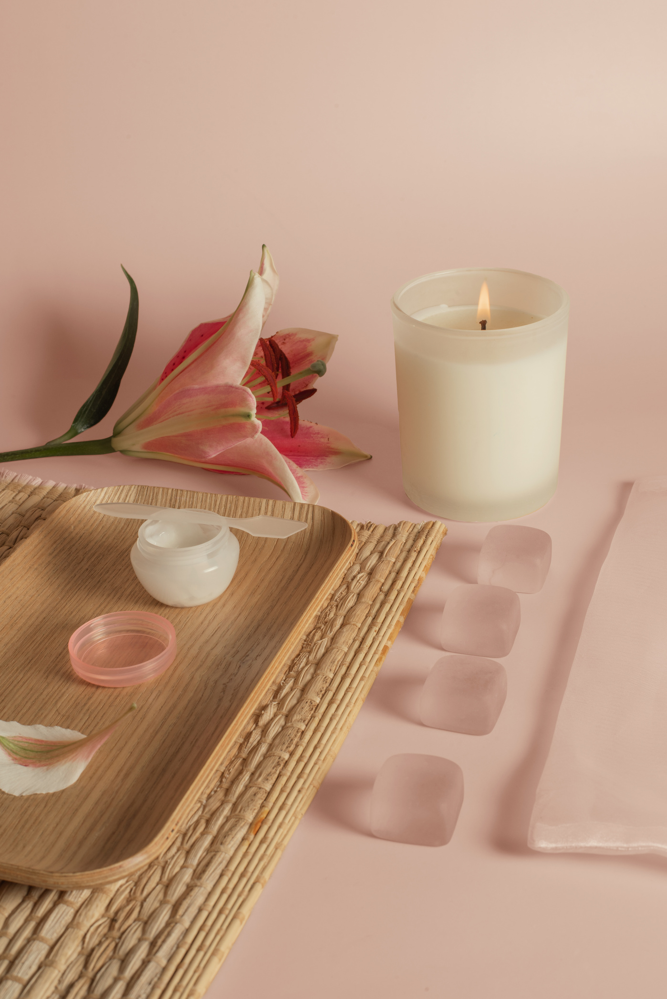
TOOLS
We have used different tools till date for different purposed. The tools we used are:
C Programming Language for source code
Draw.io for DFD, Flowchart and E-R Diagram
MS Excel for Gantt Chart
MS PowerPoint for Presentation
MS Word for Documentation
Visual Studio Code for Coding and Testing
Discord for online meeting
Terminal for application interface

Slide 19

Testing

Slide 20
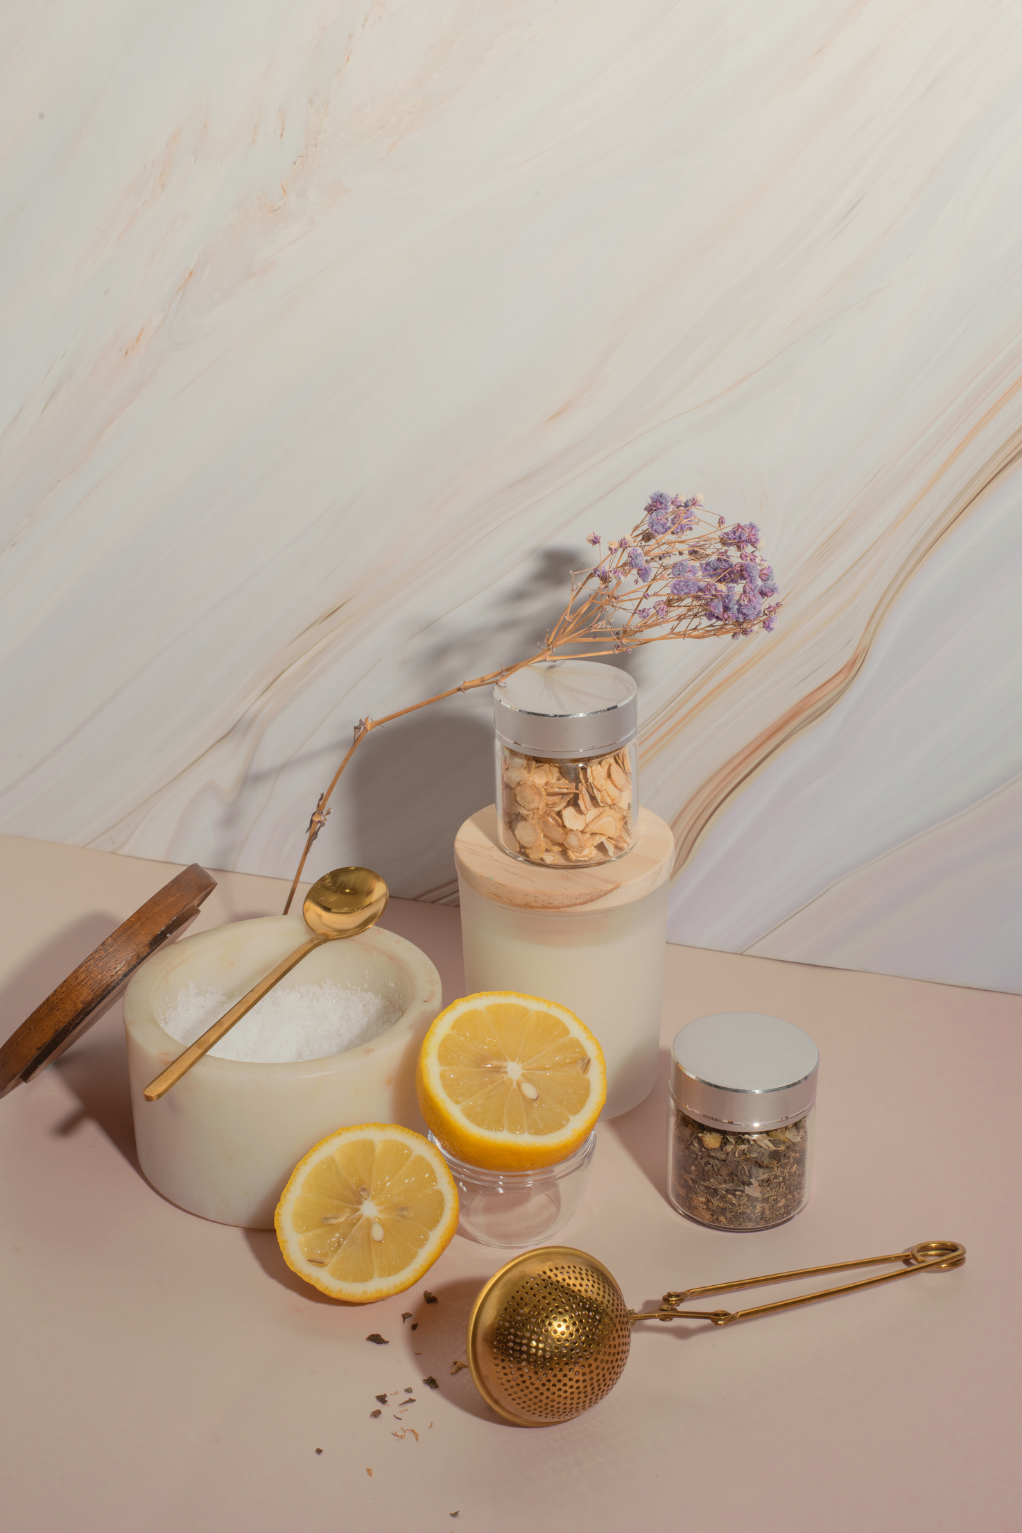
PROJECT RESULTS
KEY ACCOMPLISHED FUNCTIONS?
SOLUTIONS TO ADDRESSED PROBLEMS?
FULLFILLED REQUIREMENTS?

Slide 21
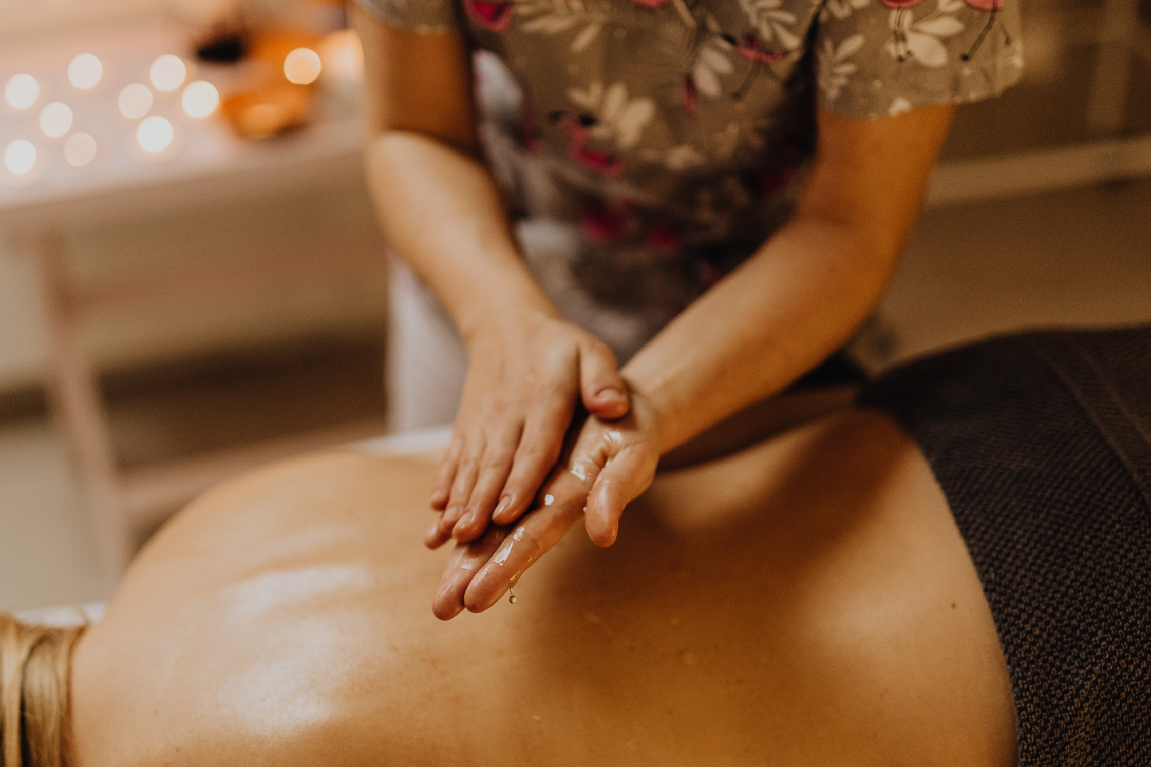
FUTURE ENHANCEMENTS
Use better database replacing current file-based database.
Add the Specification and benefits of each Spa on the menu.
Add online payment method.
Feature for saving User’s feedback in the system.

Slide 22
Any Questions?

